Slide 1
Container Security From the Bottom Up
BSidesSLC 2021
Rion Carter
Jacob Carter
Copyright 2021 Rion Carter and Jacob Carter. Redistributable under CC BY-NC-SA 4.0
Notes:
License link: https://creativecommons.org/licenses/by-nc-sa/4.0/

Slide 2
About
Rion Carter
Went to school for electronic engineering, wound up in technology and software. Loves to find and fix programs. Currently works as a Staff Engineer at VMware. On the weekends it’s been said he likes to bake desserts. DEF CON 29 speaker.
Jacob Carter
Took college courses in drafting, aviation, computer engineering, and then ended up in software out of interest. Currently works as an AppSec engineer at Domo. In his spare time he designs and builds replacement components for vintage Apple computers.

Slide 3
Agenda
0x00 - Lab Setup
0x01 - Introduction
Marketing & Selling ‘Containers’
Current state of the ecosystem
Yes… but what underpins it all?
0x02 - Overview of Isolation
Thirty-thousand Foot View
What we’re covering today
What we’re not covering today
0x03 - Linux Namespaces
What are they and how to use them
Lab work to exercise your skills
0x04 - cgroups
Purpose/function… and labs
0x05 - seccomp
A story of sycalls… and labs
0x06 - In closing…
0x07 - References & Tips
Notes:
Topic introduction
Environment Setup
Linux Namespaces
Namespace labs
cgroups
cgroups labs
seccomp
seccomp labs
Time for Questions
Additional resources

Slide 4

0x00 - Environment setup
For those who did not set up the machine in advance… or those who have issues/questions, we will spend time to get you setup
https://bit.ly/2ZQ66Mk
Items:
VMware installed
VM installed/unpacked
Login/can you shell?

Slide 5
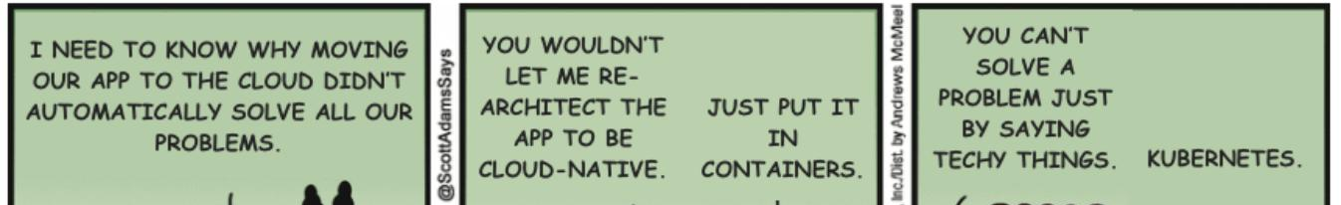
0x01 - Introduction
Notes:
Sentiment as expressed in the dilbert comic is all too common. Today we’d like to unwrap the foundational mechanisms provided by Linux which allow for resource partitioning, isolation and assignment to your workloads.

Slide 6
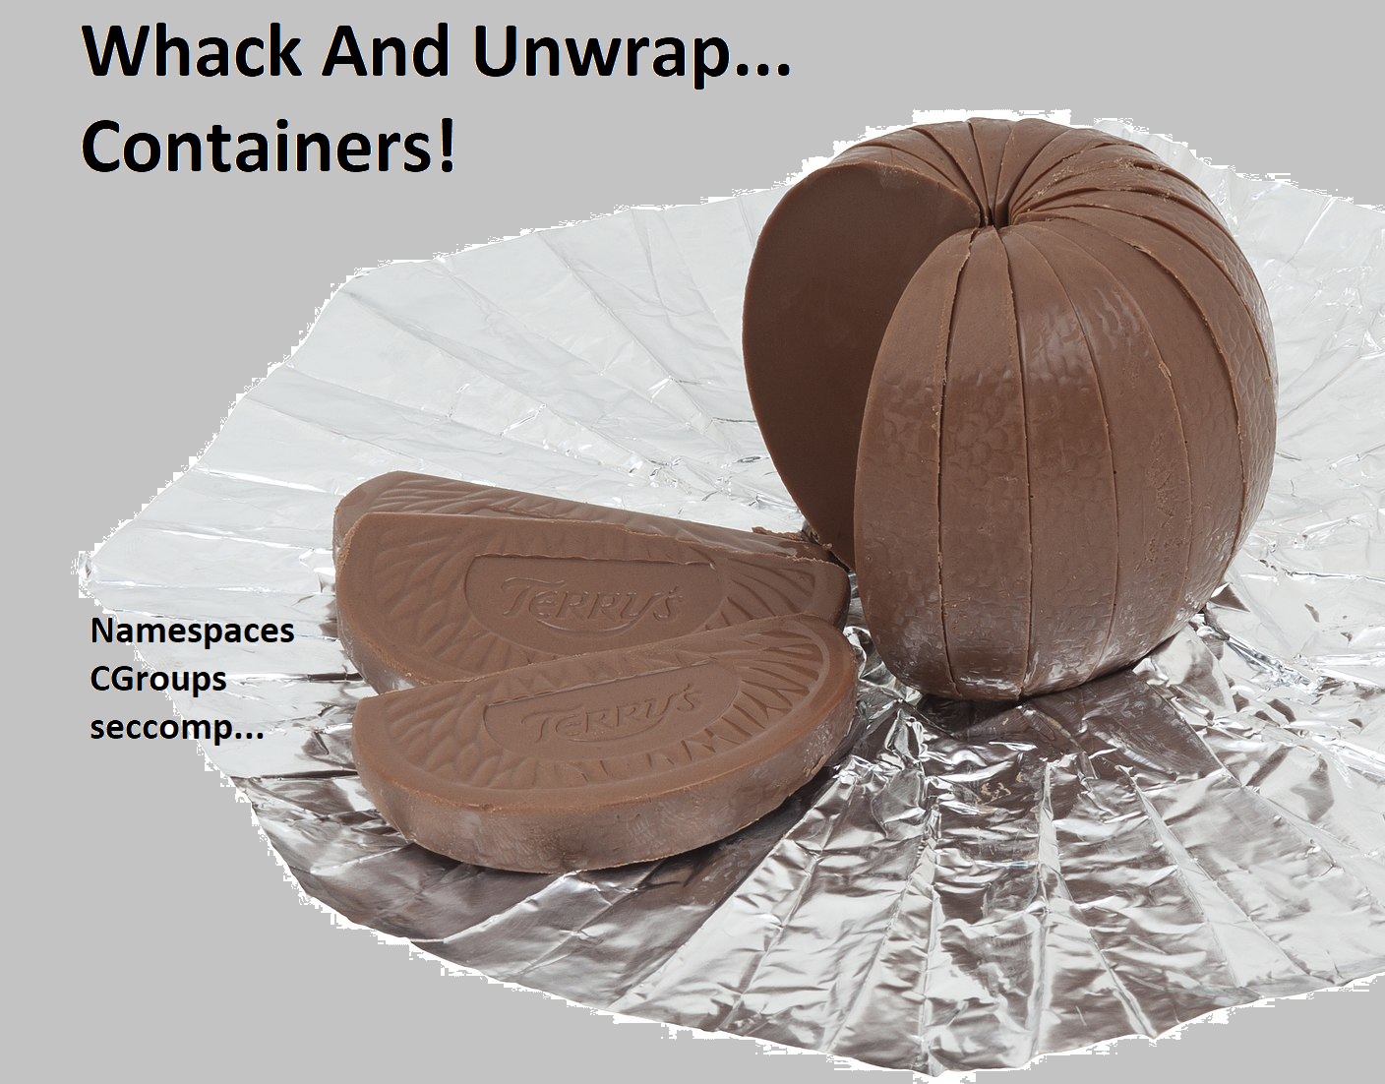
0x01 - Introduction
Containerization is a ‘marketing term’ that is more of a convention of use
Docker popularized the current ‘de-facto’ standard
Robust, fast-moving ecosystem
Widely used and not fully understood under the hood
Which is what brings us here today
Image Credits Last Slide
Notes:
Containers are billed as solving all of life’s problems and are frequently discussed as their ‘own thing’. The reality is that Linux doesn’t have a ‘native’ concept of a container - containers are a clever packaging of linux kernel features, a convenient standardized wrapper + marketing spin.
Docker, inc. popularized what is considered the de-facto ‘container’ standard, which is more a convention and a practice than it is unique technology. The value proposition is readily apparent: package and distribute your applications in a way that is consistently deployable and avoid the ‘it works on my machine!’ problem
----
Unwrap the foundational mechanisms provided by Linux which allow for resource partitioning, isolation and assignment to your workloads.
A ‘Container’ is a term used to describe packaged solutions which tap into these mechanisms. The linux kernel itself has no ‘native’ concept of a container.
Containers come in multiple flavors:
Docker-style
LXC/LXD
OpenVZ
Other platforms (Solaris, IBM Mainframes, ??)

Slide 7
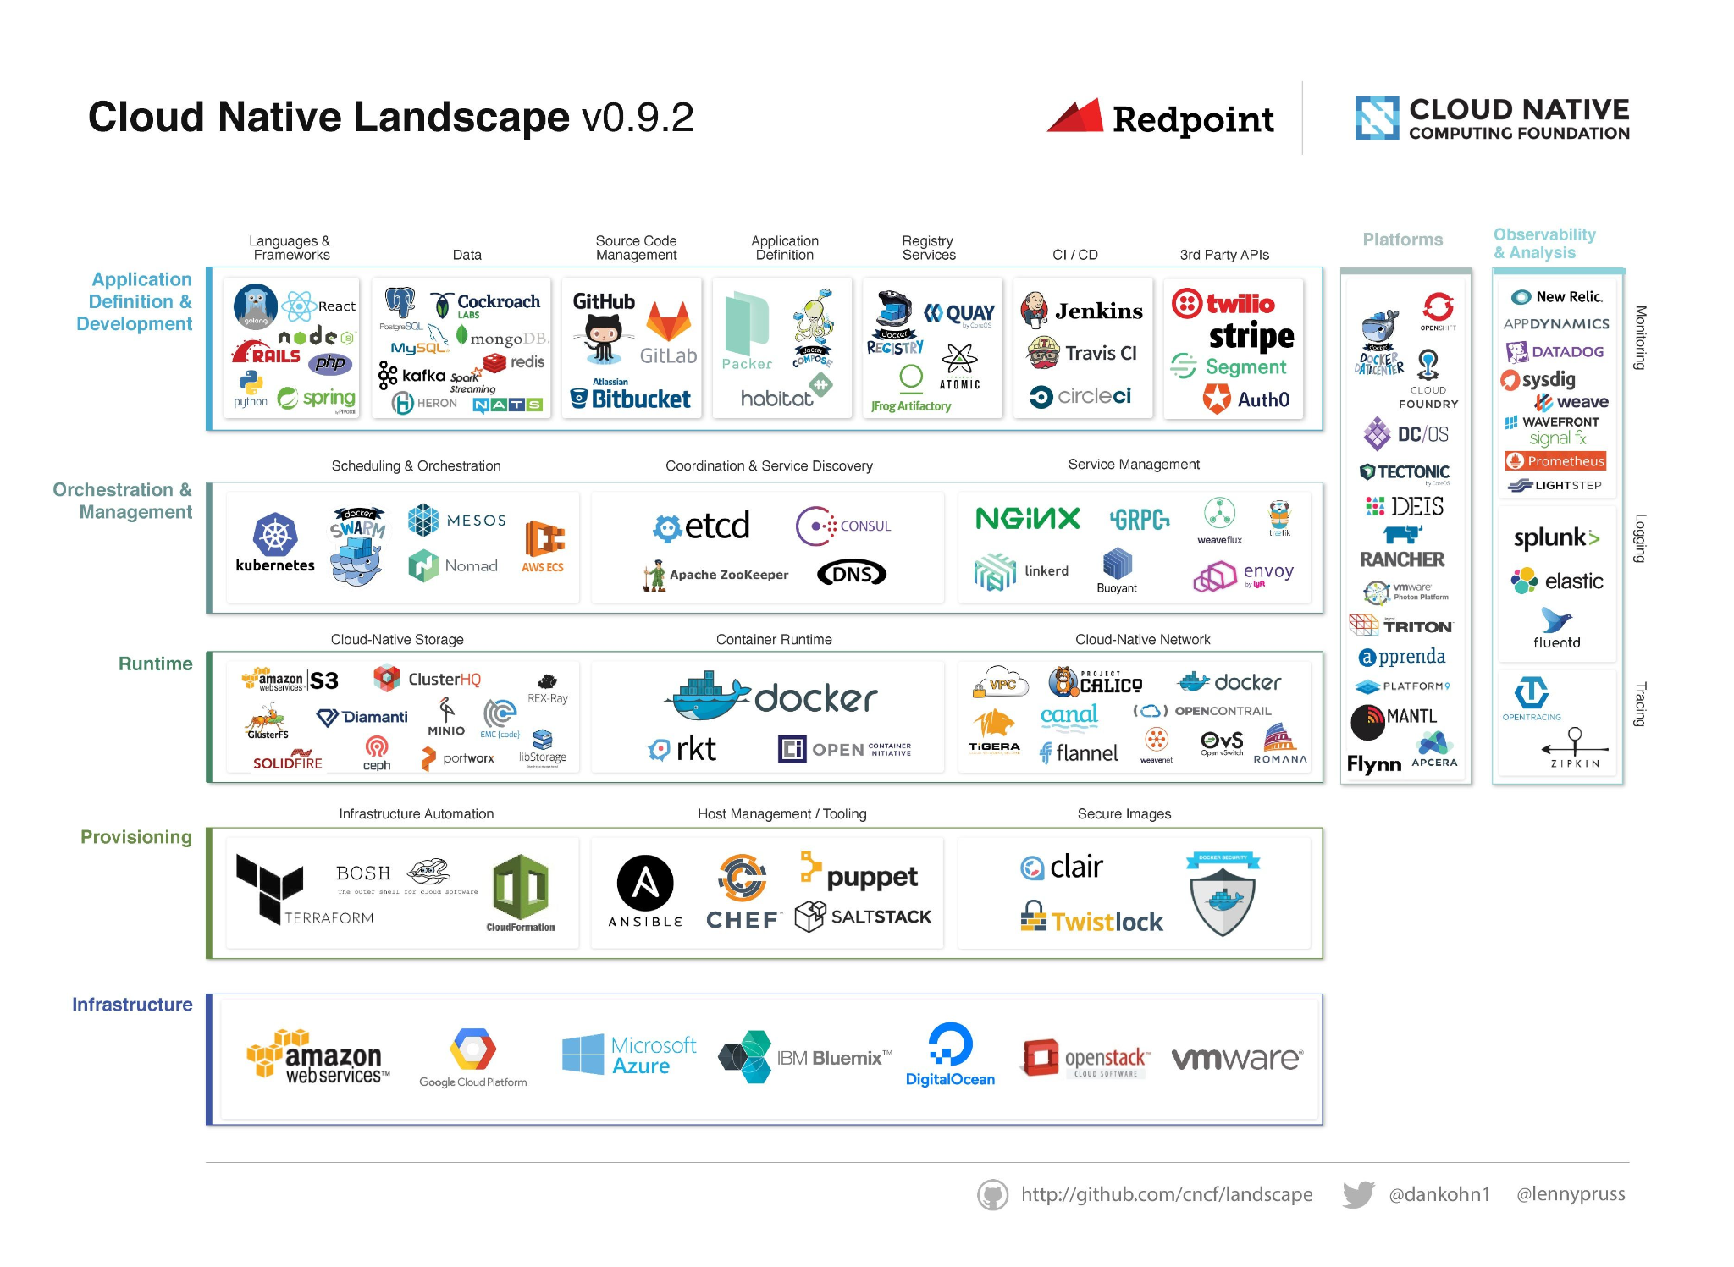
0x01 - Introduction
Current state of the ecosystem:
CNCF foundation
Sets and promotes standards
‘Owns’ many popular container OSS projects
Containerd
Manages container runtime lifecycle on hosts
Docker
De-facto standard for building images
Kubernetes
De-facto standard for container orchestration
Others
AWS ECS, podman, mesos, lxd, etc...
Intentionally too small to see.
There’s a lot here.
Notes:
The ‘container’ ecosystem evolves rapidly. In the space of a few short years the conversation has switched from focusing on Docker inc to OSS projects governed by the Cloud Native Computing Foundation (CNCF). There continues to be iteration, improvement and evolution of the projects that make up our current container landscape.
When attempting a view of this ecosystem from the ‘outside in’ it’s worth noting the key landmarks:
Software is packaged as ‘container images’
These software packages can be executed wherever you have a runtime component
At scale you need tools to administer and manage your software deployments, which is where Orchestrators like Kubernetes come into play
As you view this landscape it’s taken for granted that there are underlying technology components that provide the isolation necessary to make any of this happen

Slide 8

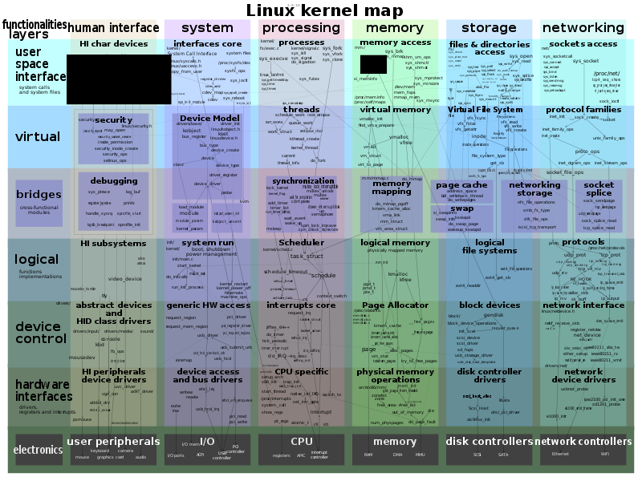
0x01 - Introduction
What underpins the ecosystem?
Linux resource isolation technologies:
Namespaces
CGroups
Seccomp
eBPF
Capabilities
Linux Security Modules (LSM)
This is a seriously cool SVG
Notes:
Most visibility into the container ecosystem is centered at the top layers of the stack as this is where the business enablement comes into play - it’s how you can take the applications your company develops, and lets you deploy them for use by your customers.
What underpins this ecosystem? Why, it’s the humble linux kernel! While the layers of abstraction make the experience a smooth one, it should be remembered that it is the isolation and control mechanisms of the linux kernel that make containerization possible/useful.
Image link: https://commons.wikimedia.org/wiki/File:Linux_kernel_map.svg

Slide 9
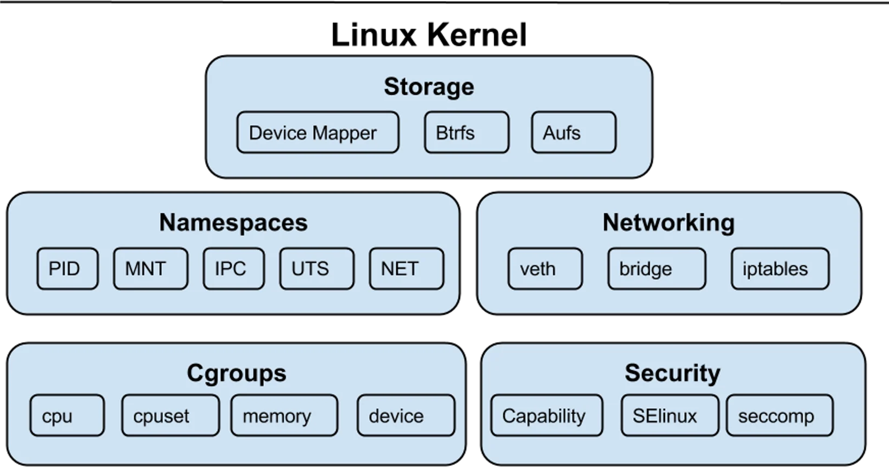
0x02 - Overview of Isolation
Linux Isolation technologies:
Namespaces
CGroups
seccomp-bpf
Capabilities
Linux Security Modules (LSM)
Notes:
At its core Linux is a kernel, which means it has direct control over all system resources. It provides interfaces for software applications to interact with and make use of hardware found on a system. As an extension of this, Linux also provides mechanisms to isolate running application processes from each other.
In summary, there are a mechanisms that are available to isolate application processes:
Namespaces
Provides kernel resource partitioning and isolation, so processes that do not share a namespace cannot see each other’s namespace-gated resources
Namespaces are a core component of current ‘container’ technology and allow for containerized application processes to run without the ability to view or manipulate files or system settings used by the host system.
CGroups
Configures permitted system resource usage (CPU, RAM, Disk IO Bandwidth Limitations, etc. Per Process Group)
Can prevent a runaway process from impacting other workloads on your system
seccomp-bpf
This is an advanced mechanism that can be used as a kernel syscall firewall. By using this you can whitelist which syscalls are allowed and which will cause a program to cease execution
While Seccomp profiles can be implemented by executables directly, docker provides a straight-forward way to apply these profiles to binaries that don’t include this functionality natively
Capabilities
For processes that require ‘some’ but not all of root/super-user permissions to operate, Linux gives you the option of parcelling out subsets of ‘root’ privileges to users. Examples include:
CAP_CHOWN - Let the process make changes to file user/group ownership
CAP_NET_ADMIN - Perform network-related operations on a system
CAP_NET_BIND_SERVICE - Bind a socket to a ‘privileged’ port (less than 1024)
CAP_NET_RAW - Allows for both RAW and PACKET socket types. Also allows for binding to any address for transparent proxying
CAP_SYS_ADMIN - **Highly overloaded** and over-scoped
… and many, many others!
Linux Security Modules
LSMs can provide additional isolation for application processes by layering additional checks/controls on top of the typical linux permissions associated with filesystems
Examples of these include SELinux and AppArmor
Out of scope for today’s presentation

Slide 10
0x02 - Overview of Isolation
Linux Isolation technologies:
Namespaces
CGroups
seccomp-bpf
Capabilities
Linux Security Modules (LSM)
Not included in today’s workshop:
Capabilities
Linux Security Modules (LSM)
Filesystems & Storage
Notes:
We’re already covering a lot of ground today, and there’s not going to be enough time to touch on Capabilities, storage or Linux Security Module system.

Slide 11
0x03.0 - Linux Namespaces
User
Mount
Isolates kernel resources
Kernel-virtualized sandboxes are provided for use by system processes
The Kernel is shared among all namespaces
PID
IPC
UTS
Time
Net
CGroup
Notes:
Namespaces are used to isolate kernel resources or present a different view of the system to a given process.
Namespaces virtualize kernel resources. They don’t use CPU virtualization instructions, because we’re not virtualizing hardware. Your container can’t run a different operating system or have a different kernel version. But a namespace can perform similar isolation of kernel resources, so that one process simply cannot see resources that are available to another process (presuming you haven’t found a bug in the kernel).
Because this is process-level isolation, and not full hardware level isolation, the same Linux kernel is called by all processes no matter what namespace they are in.

Slide 12
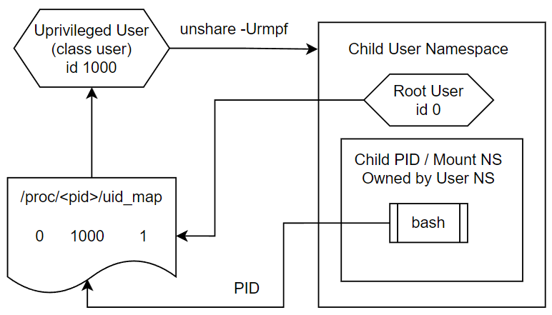
0x03.1 - Linux Namespaces : User
Isolates:
User ids
Group ids
Keyrings
Capabilities
Maps:
userIds
groupIds
Notes:
The user namespace provides mapping and isolation for user ids, group ids, keychain entries, and linux Capabilities.
Unshare makes it really simple to map your in-namespace user to appear as root, and for maximum security you can configure your user not to be root in the namespace.
Root in the user namespace does grant some powers over other namespaces which are associated with your user namespace, thanks to Linux Capabilities which we don’t really have time to talk about today.
Just like the slide calls out /proc/pid/uid_map there’s one for group IDs too.
-------------------------------------------------------
Having a capability inside a user namespace permits a process to
perform operations (that require privilege) only on resources
governed by that namespace. In other words, having a capability
in a user namespace permits a process to perform privileged
operations on resources that are governed by (nonuser) namespaces
owned by (associated with) the user namespace (see the next
subsection).
On the other hand, there are many privileged operations that
affect resources that are not associated with any namespace type,
for example, changing the system (i.e., calendar) time (governed
by CAP_SYS_TIME), loading a kernel module (governed by
CAP_SYS_MODULE), and creating a device (governed by CAP_MKNOD).
Only a process with privileges in the initial user namespace can
perform such operations.
Holding CAP_SYS_ADMIN within the user namespace that owns a
process's mount namespace allows that process to create bind
mounts and mount the following types of filesystems:

Slide 13
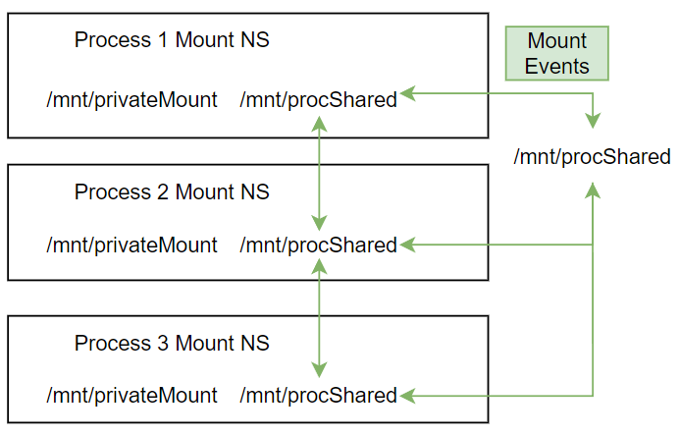
0x03.2 - Linux Namespaces : Mount
Isolates mount points
Provides mechanisms to propagate mount events
Shared
Slave
‘Containers’ can isolate their root from host root
Notes:
The mount namespace allows for mount point isolation. Create a new mount in one namespace, and it is not visible to another unless you configure it to be.
You might expect that making a new mount namespace would isolate your process by default, so it can’t see existing mount points. But it doesn’t work that way, and actually can’t. If all your mount points went away, what program binaries could you execute? None. Because of this, mount points are automatically inherited to your new namespace so your binaries don’t all disappear and leave your process stranded. The labs will get into how you can then isolate things.
Mount points across namespaces can be configured to share mount events. Maybe you have a DVD drive on the physical host that you want to share across a set of containers. Maybe there’s a shared mount point which is used by processes for drive images or other mount-related things. These mounts can be configured as ‘shared’ where all mount events are shared around a configured ‘peer group’. Or could be configured as ‘slave’ where they receive mount events from a their configured replication master but any mount operations which they perform inside that slave mount are not propagated back up.
The graphic shows a shared mount point in a peer group, so all mount events in any of these locations will be propagated to all of the others.
And of course there are also private mount points in each namespace which do not propagate events. And are simply not visible to other processes.

Slide 14

0x03.2 - Linux Namespaces : PID
Notes:
Presently my favorite slide

Slide 15
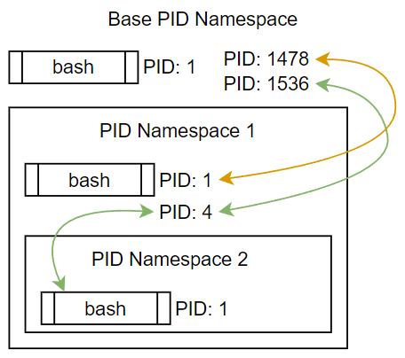
0x03.2 - Linux Namespaces : PID
Isolates Process IDs
Parent PID NS can see processes in child NS
But child can’t see in parent
Used in conjunction with IPC and other namespaces
Notes:
The PID namespace provides Process ID Isolation. Big surprise, PID = Process ID right?
Why would you want to isolate process IDs? Try running the command `ps -ef` and look at all the output. PID data reveals running processes, paths, arguments, lots of information about the system at large.
PID namespaces can be nested and can form a tree structure, with an ancestor node above and multiple child / sibling nodes below.
A parent PID namespace can see the processes running in the child namespaces. So the root PID namespace can see all, but the child cannot look upward to see parent PID information. Sibling PID namespaces (not pictured here, but supported) also can’t see each other’s process information.

Slide 16
0x03.3 - Linux Namespaces : IPC & Time
IPC Namespace isolates certain IPC mechanisms
SystemV
Message Queue
Semaphore
Shared Memory
POSIX Message Queues
Time Namespace provides offsets for:
CLOCK_MONOTONIC
CLOCK_BOOTTIME
Notes:
The IPC namespace provides IPC isolation. You know, it’s almost like they named these namespaces after what they actually do.
SystemV IPC mechanisms and POSIX message queues are isolated to the namespace in which they are created.
If you have a rogue or compromised process, isolating away these IPC mechanisms decreases the attack surface.
The time namespace is a little odd. It allows you to provide an offset for the monotonic and boot time system clocks.
These clocks are presumed to always be increasing and must *never* decrease, because they are used as sources for timers and other things. You would use this namespace as part of a restore operation, to ensure that the clocks are in the future from when the process was stopped.

Slide 17
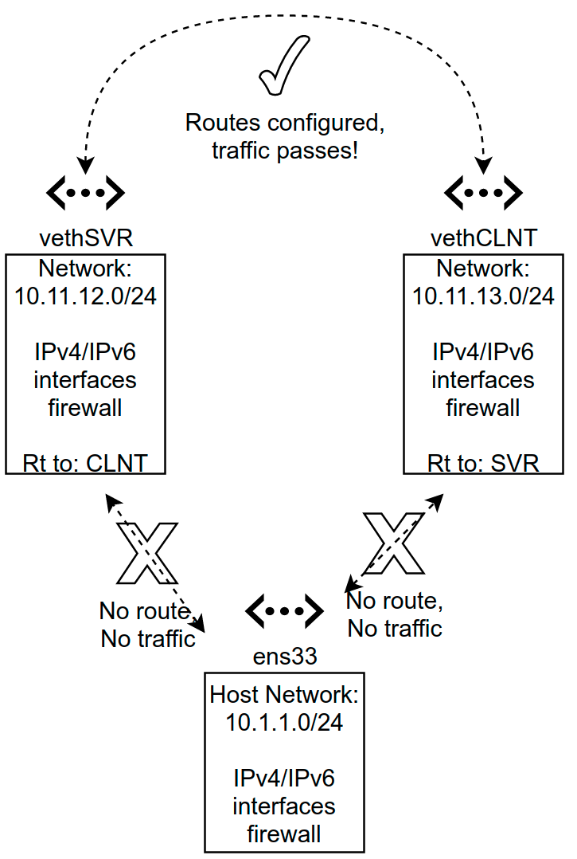
0x03.4 - Linux Namespaces (Network and UTS)
Isolate ‘global’ resources such as: devices, IP stack, routing & firewall
Network interfaces can be bound to a single namespace
Network namespaces are isolated from each other
UTS namespace is a bit useless
Notes:
The Network namespace is used to provide isolated network environments where processes can appear to have their own IP address. The network namespace also isolates UNIX domain sockets and iptables rules.
Multiple processes can share the same set of namespaces, which allows for easy network-communication between the processes. Additionally, you can configure routing between network namespaces. These namespaces can be restricted in what they can access - you may have network namespaces that communicate with the host, with other namespaces or only the outside internet.
It’s worth noting that the host network can be isolated from the spawned network namespaces. ‘Host network’ only sees what is bound to it and can only access resources in spawned-namespaces if subnets/routing are configured.
For investigative purposes you can attach diagnostic and/or inspection tools like tcpdump to arbitrary network namespaces to investigate and understand how these namespaces are configured.
The UTS namespace (short for ‘unix time sharing’) can be used to set a ‘hostname’ and NIS domain name that are unique/separate from the host system. According to lwn, there was a use-case associated with OpenVZ that made this desirable. OpenVZ is primarily used to supply virtual private servers (VPS) for low-cost shared hosting environments.
Refs:
https://itnext.io/create-your-own-network-namespace-90aaebc745d
https://windsock.io/uts-namespace/
https://lwn.net/Articles/179345/

Slide 18
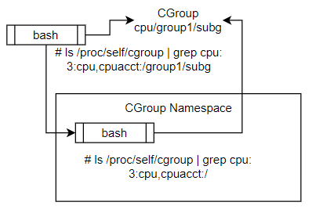
0x03.5 - Linux Namespaces : CGroups
Provides isolation of CGroup naming path
Allows process migration between systems
Prevents self-modification of CGroups
Notes:
CGroups are both namespaces and their own separate thing. Here we’re talking about the namespace version.
In this diagram, the outer bash (top left) is assigned into the CGroup shown. When it creates a child process, that child process is automatically inherited into the CGroup of its parent. In this example that child process is in a new CGroup Namespace as well.
The parent process can ls /proc/self/cgroup and see the cgroup sub-path. The child process cannot, because its CGroup namespace prevents the child from seeing the sub path even though that process is indeed in that group. This is useful for hiding container framework information.
The documentation says that CGroup namespaces allow for process migration because their parent CGroup paths are hidden from the process. If not, then the entire unique CGroup path would have to be copied to the new system.
Another interesting point from the documentation is that CGroup namespaces can prevent a process which owns the CGroup mount from writing to CGroup configuration files. If your parent bash process creates the cgroup mount and applies it, then you own that cgroup mount and can modify settings. But if you then namespace away the CGroup for child processes, they can’t see and modify CGroup settings despite technically having rights to by virtue of the user they’re running as.

Slide 19
0x03.42 - Namespace Labs
Run the labs
Also time for questions about the labs

Slide 20
0x04.0 - CGroups (Control Groups)
A CGroup is a set of processes which are bound together under a Subsystem / Resource Controller which limits or controls certain system resources.
CGroup V1 root on Ubuntu: /sys/fs/cgroup CGroup V2 root on Ubuntu: /sys/fs/cgroup/unified
Can use V1 or V2 per Subsystem, not both.
Notes:
We just looked at the CGroup Namespace. That namespace isolates away the view of the actual CGroup filesystem. Now we’re talking about CGroups themselves.
They behave nothing like the namespaces we’ve been talking about. Namespaces limit what your process can see. CGroups limit what your process can use.
Subsystems and Resource Controllers are mentioned in the documentation and they’re basically the same thing. They are the types of CGroups which exist.
Shown on the slide are where the various versions of CGroups are auto-mounted on Ubuntu. Yes, these are a type of mounted filesystem and you interact with their control files. Each controller has its own control filesystem and wow are there a lot of these.
Also yes, there are two versions and V1 is unlikely to ever go away. But the controllers are only allowed to be used one version at a time. You can’t use V1 cpu and V2 together - this isn’t supported.

Slide 21
0x04.1 - CGroups V1 Subsystems
blkio
cpu
cpuacct
cpuset
devices
freezer
hugetlb
memory
net_cls
net_prio
perf_event
pids
rdma
Notes:
Control Groups, or CGroups, are a way to group and organize processes together such that their system resource usage can be constrained.
CGroups V1 Subsystems are applied at the process level, but can also be so granular that you can split a thread across different CGroups. The documentation says that in practice the crazy threading abilities of CGroups V1 actually caused some problems. Imagine threads in the same process executing in different memory CGroups. Confusing in the extreme, and most thread-level application was removed in V2.
Blkio: Applies throttling to “block device” access from grouped processes. (block device as in storage: CD, DVD, hard drive, etc)
Cpu: Configures CPU usage. Can set a soft limit with ‘shares’, where processes are allowed to go over their configured limit if the remaining shares are unused by other processes. Or you can set set a hard limit with the cpu quota and period config files. There’s a lab on the cpu CGroup.
Cpuacct: (CPU Accounting) Provides information about the CPU usage of all processes in the control group. Reporting is done on all processes together, one big bucket.
Cpuset: Binds processes to a particular CPU or NUMA node
Devices: Acts as a whitelist to control which processes can create devices, as well as read/write against them
Freezer: Suspends and restores processes in the group. Suspending a parent CGroup will suspend child group processes.
Hugetlb: Can limit the use of huge pages in grouped processes
Memory: Limiting and reporting of process memory, kernel memory, and swap usage. This also supports soft and hard limits, though unlike CPU you can’t really throttle memory usage so your process is SIGKILL-ed once the limit is exceeded.
Net_cls: Adds class ID information to network packets sent from grouped processes. This can be used by firewall and other processes to filter network packets.
Net_prio: Allows setting network priority for grouped processes
Perf_event: allows for performance monitoring of grouped processes
Pids: Can limit the maximum number of process IDs that exist across all grouped processes. The other CGroups lab is on this.
Rdma: Allows limiting RDMA and IB-specific resources per group. RDMA is ‘remote direct memory access’ and IB is InfiniBand
Each CGroup Controller can be used either in V1 mode or V2 mode - not both simultaneously
CGroups V1 is stated to have been ‘unorganized’ by man7.org, and reading the docs make it sound that way.
CGroups are hierarchical, and appear in the filesystem as a directory structure with a variety of files which are written to for configuration, and informational files that are read from.
Same for ‘devices’ CGroup, you can attach an eBPF filter program under the devices filesystem entry in V2.

Slide 22
0x04.2 - CGroups V2 Subsystems
cpu
cpuset
freezer
hugetlb
io
memory
perf_event
pids
eBPF system
rdma
Devices
IPtables
Notes:
CGroups V2 has mostly the same subsystems. More or less, functionality is the same.
Administration is a little different because unlike V1, all of the Subsystems are mounted under a single directory instead of allowing them higgledy-piggledy wherever you want.
Note that cpu, perf_event, and pids are highlighted. These can optionally be run in threaded application mode if the feature is turned on.
Net_cls and net_prio have been moved into IPTables as eBPF (embedded Berkeley Packet Filter) operations
The Devices namespace now operates entirely on the eBPF programs as well.

Slide 23
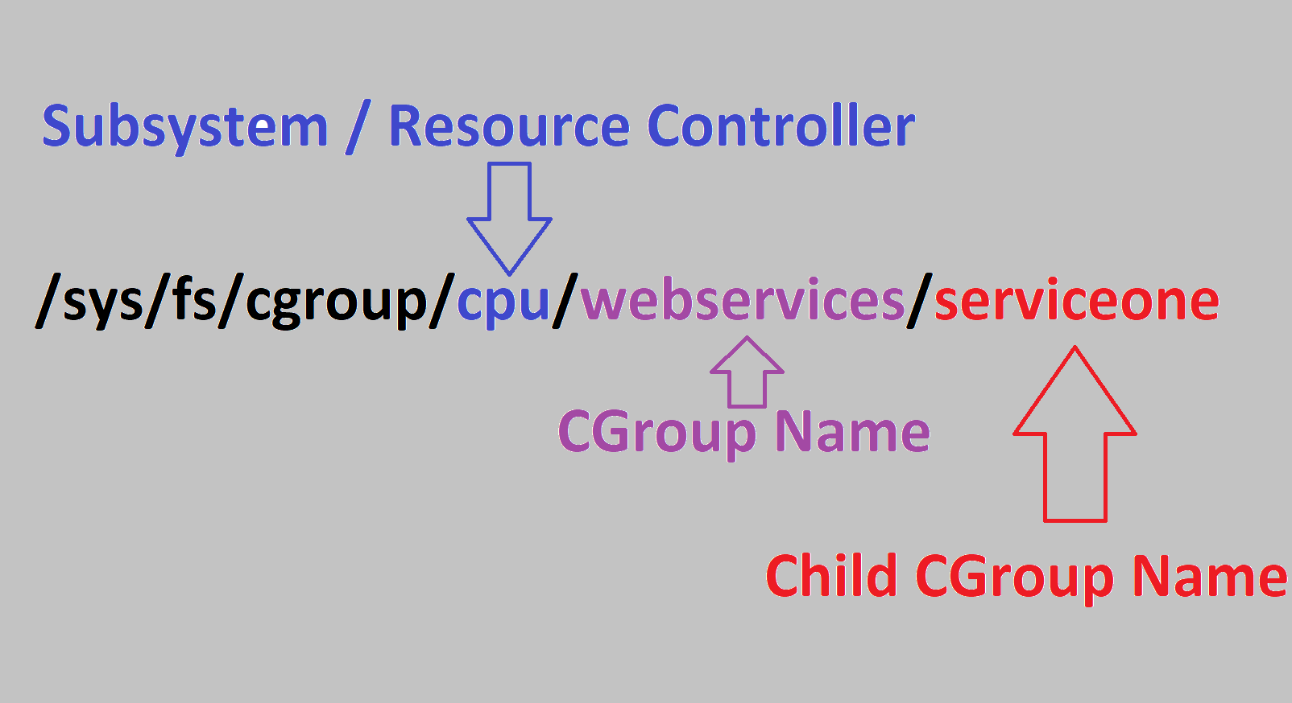
0x04.3 - CGroups Hierarchy
CGroup control files are structured in a hierarchy. For example:
/sys/fs/cgroup/cpu/webservices
/sys/fs/cgroup/cpu/webservices/serviceone
/sys/fs/cgroup/cpu/webservices/servicetwo
Notes:
CGroups are a hierarchy, so you can have a parent group which sets overall limits for your processes and also child groups to fine tune each individual process.
Each of these child CGroups has all of the same configuration files as the parent groups.
On this slide, webservices is the parent group. serviceone / servicetwo are child cgroups.

Slide 24
0x04.4 - CGroups Control File Structure
CGroups each have their own unique control file structure.
Pids CGroup:
cgroup.clone_children
cgroup.procs
notify_on_release
tasks
pids.current
pids.events
pids.max
Devices CGroup:
cgroup.clone_children
cgroup.procs
notify_on_release
tasks
devices.allow
devices.deny
devices.list
Notes:
These are examples of the files present in two cgroups.
Some of these files are written to for configuration, such as the Pids cgroup ‘pids.max’ file, or the devices cgroup ‘devices.allow’ and ‘devices.deny’.
Others are read-only, like pids.current.
Every cgroup has unique configuration, which makes sense given that they manage different system resources.
Some of these files are found across most cgroups, like cgroup.procs, cgroup.clone_children, notify_on_release, and tasks.

Slide 25
0x04.5 - CGroup Labs
Lab 1, where PIDs are your oyster (until they’re not)
Lab 2, where CPUs are controlled
Questions?

Slide 26
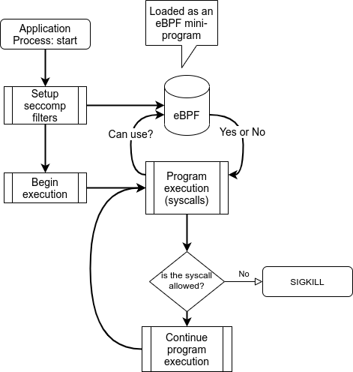
0x05 - seccomp
Restricts the number of syscalls available to a process
Two modes of operation
STRICT
FILTER
FILTER mode is powered by eBPF
Whitelist syscalls + arguments
Acts as a kernel-mode firewall
Docker provides a seccomp profile
Defaults to block potentially-hazardous syscalls
Notes:
Seccomp has been around for a long time (since 2005) with a goal of reducing the kernel’s attack surface. Linux has hundreds of syscalls which let applications request actions to be performed by the kernel, most of which lie dormant for the entire lifecycle of most application processes. Like any other piece of software the kernel has its share of bugs, so reducing exposure to syscalls limits the ability for an application process to trigger a fault condition.
In the context of our presentation today, we can see how limiting exposure to the kernel can benefit us in the event that an application process becomes compromised by an attacker. If there are fewer syscalls available, there are fewer potential avenues of attack against our system which is a form of `defense in depth`.
Seccomp has 2 modes of operation:
STRICT
FILTER
‘STRICT’ mode is not in context for today’s presentation - it is the original mode which allows only 4 hard-coded syscalls (read(), write(), exit() and sigreturn() ). That small set of syscalls is not typically sufficient to run a modern network-bound application.
FILTER mode was introduced in 2012 and allows the use of eBPF mini-programs to allow or deny syscalls either entirely or based on certain argument values passed in by the calling application. eBPF is an in-kernel virtual machine with its own language and capabilities. We aren’t going into depth of eBPF in this presentation. It is worth noting that eBPF is one of the most substantial changes to the linux kernel in recent years and it is a center of attention for future kernel enhancements.
We can consider seccomp as a sort of kernel firewall that sits between your application process and the kernel proper. Docker provides a default seccomp filter out of the box which filters certain ‘significant’ syscall
Refs:
https://lwn.net/Articles/656307/
https://en.wikipedia.org/wiki/Seccomp
https://docs.docker.com/engine/security/seccomp/
https://github.com/moby/moby/blob/master/profiles/seccomp/default.json

Slide 27
0x05 - seccomp Labs
Lab 1
Lab 2
Questions?

Slide 28
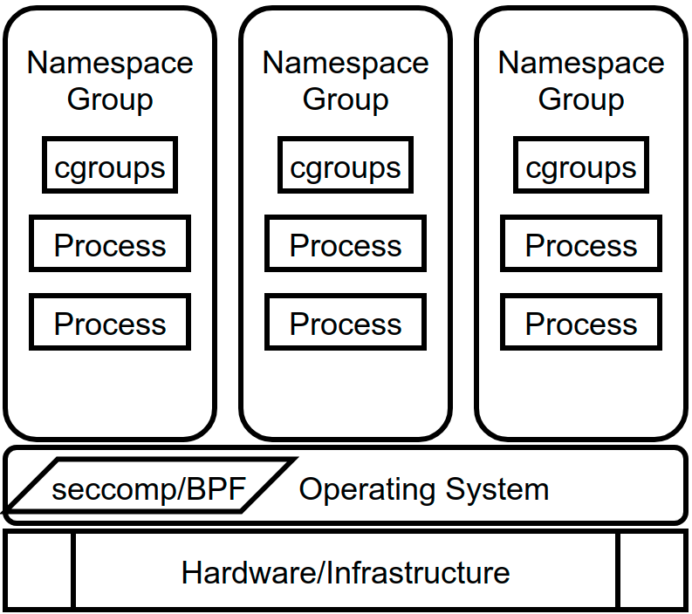
0x06 - In Closing...
Linux underpins the entire ecosystem
Each control mechanism has its own knobs to turn
Taken together these mechanisms provide for light-weight and effective isolation of processes and resources (aka `containerization`)
Notes:
In closing we’ve reviewed a number of the significant mechanisms that the linux kernel provides to reserve and isolate system resources. These mechanisms are at the core of present-day containerization implementations and it’s safe to say that the current innovation in the ‘container’ space would not be possible without the hard work of kernel developers who make these features possible.
We hope you’ve enjoyed this rapid-fire tour and associated labs.
There’s a lot more firehose to drink from on these subjects should you desire to quench your thirst.

Slide 29
Questions?
Now is your time!

Slide 30

Thank you!
Rion Carter
7thzero.com
Jacob Carter
androda.work

Slide 31

Further Reading
Always start with “The Man”
https://man7.org/linux/man-pages/man7/namespaces.7.html
https://man7.org/linux/man-pages/man7/cgroups.7.html
https://www.schutzwerk.com/en/43/posts/linux_container_intro/
https://news.ycombinator.com/item?id=29265061
https://redhatgov.io/workshops/containers_the_hard_way/
https://www.redhat.com/sysadmin/mount-namespaces
https://linuxcontainers.org/lxd/introduction/
https://lwn.net/Articles/740157/
‘Precursor technology’ like jails, chroot, Solaris stuff, IBM stuff

Slide 32
Image Credits
Environment Setup slide
https://pixabay.com/illustrations/synthwave-retrowave-synth-3941721/
Image on Introduction slide based on:
https://en.wikipedia.org/wiki/Terry%27s_Chocolate_Orange#/media/File:Terrys-Chocolate-Orange.jpg
https://commons.wikimedia.org/wiki/User:Evan-Amos
Thank you slide
https://pixabay.com/illustrations/city-sunset-night-landscape-urban-5848267/
Others that are cool:
https://www.flickr.com/photos/xmodulo/26534955924 (namespaces)
https://commons.wikimedia.org/wiki/File:Linux_kernel_map.svg (linux kernel)
https://commons.wikimedia.org/wiki/File:Zombie_process.png (zombie process)

